Slide 1

Analysis of Road Traffic Safety and Congestion Using Big Data
Team Uncharted
Mahamaya Panda
Aradhya Alva Rathnakar
Bhavan Kumar Basavaraju
Shashi Kumar Kadari Mallikarjuna
ReddySaketh Reddy Chappidi

Slide 2

Agenda
Introduction
Problem Statement and Solution
Objectives
Motivation
Development Methodology
Project Workflow
Dataset source
Entity-Relationship Diagram
Live Code Walkthrough
A Comprehensive Exploration
Conclusion
Future Scope

Slide 3
Introduction
In today's urban environment, the challenges of road traffic and crashes are widespread, growing in complexity with expanding cities.
Big Data's emergence has enabled real-time traffic data collection and analysis, driving more efficient traffic management and infrastructure improvements, offering innovative solutions to reduce vehicle crashes.

Slide 4

Problem Statement and Solution
Problem:
Due to the increase in population density, there is an increase in road traffic and vehicle crashes in the urban landscape.
Solution:
To solve this problem, our project aims to use big data analytics to address road traffic safety and crash issues by analyzing vehicle crash data to develop data-driven solutions for enhanced road safety and reduced vehicle crashes in urban areas.

Slide 5
Objectives
Collecting and integrating vehicle crash data from government transportation related websites.
Implementing intelligent traffic management strategies and real-time interventions based on crash data-driven insights.
Optimizing urban infrastructure planning to accommodate growing traffic demands efficiently.
Enhancing the overall commuting experience for residents by reducing crash-related delays and essentially reducing pollution from vehicles.

Slide 6

Motivation
With the increase in population and road traffic, vehicle accidents are drastically increasing. The emergence of Big Data revolutionizes traffic management, and infrastructure planning to reduce accidents.

Slide 7
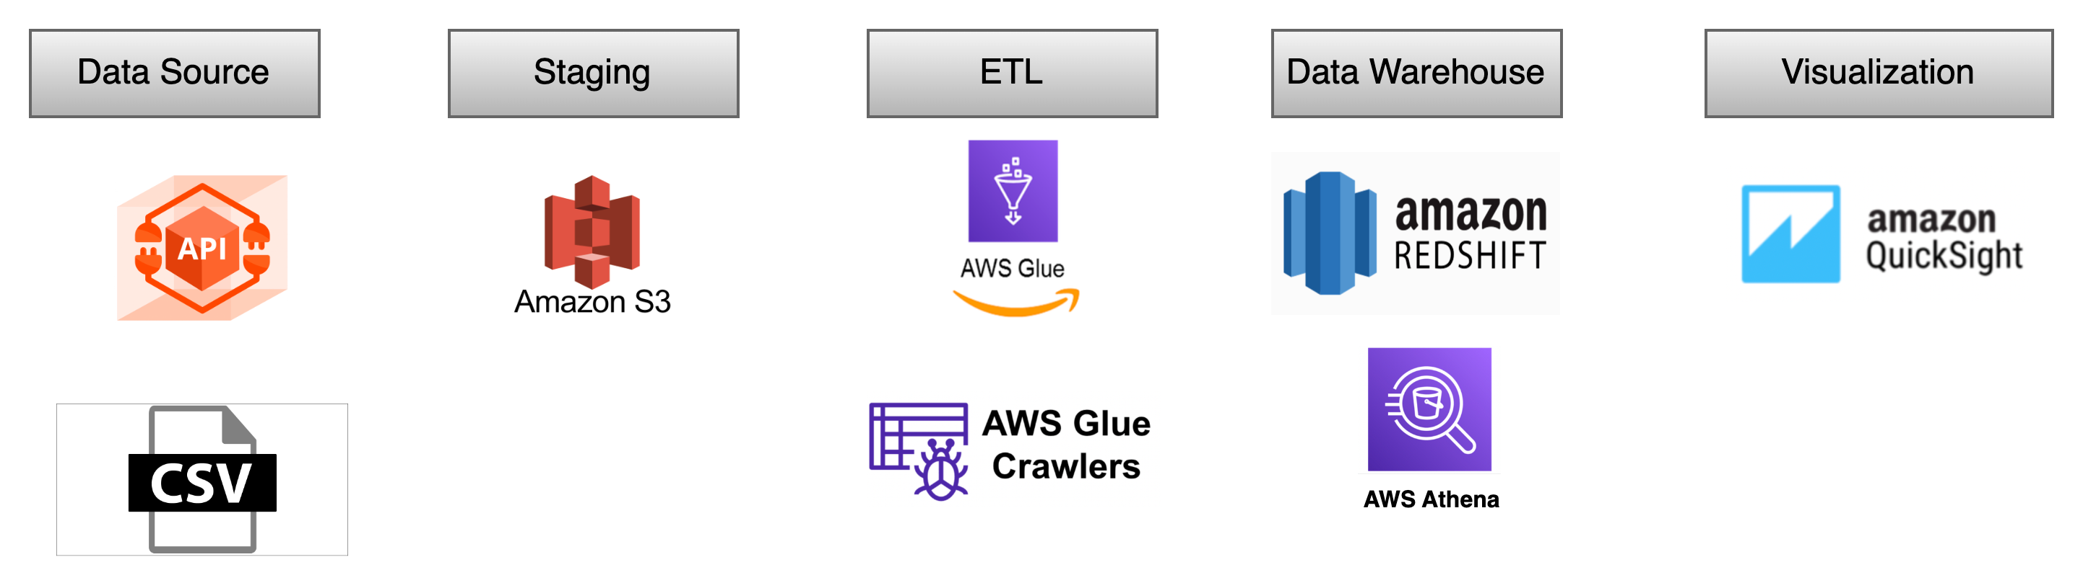
Development Methodology

Slide 8
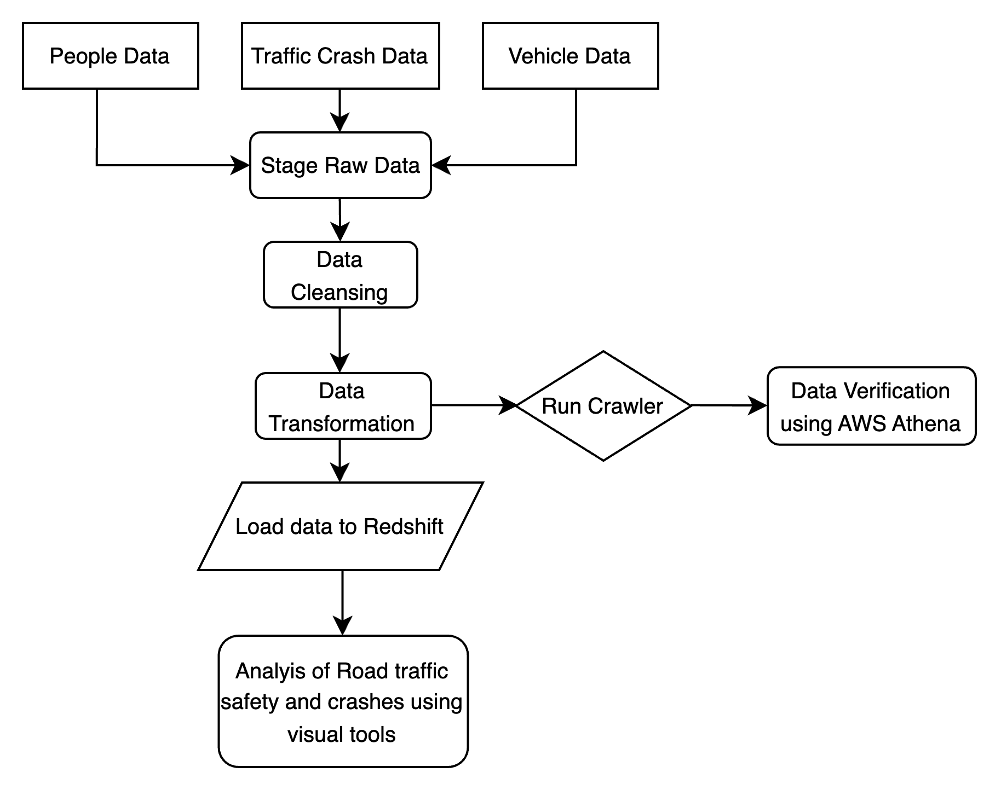
Project Workflow

Slide 9
Data Source
Data Source: Chicago Data Portal website: http://www.chicago.gov
Data contains information about people involved, any injuries sustained, vehicles involved, and crashes that took place in the city of Chicago.
The Chicago Police Department reports crash data on the Chicago Data Portal, aligning with the IL Traffic Crash Reporting form SR1050.
The latest data was updated on November 28, 2023 in the data portal.
Owner of the data is Jonathan Levy.

Slide 10
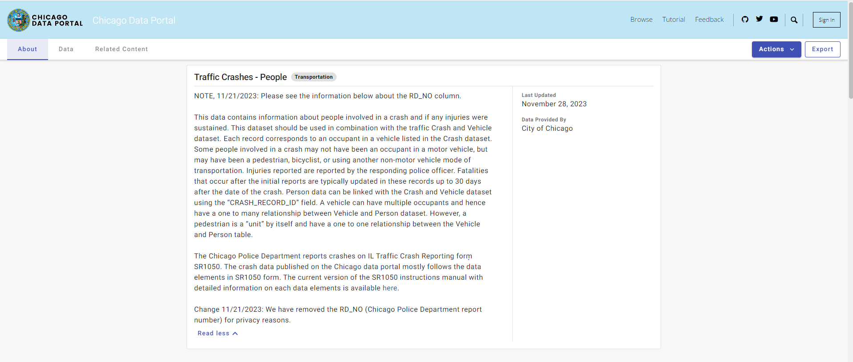
Dataset description – People involved in crash

Slide 11
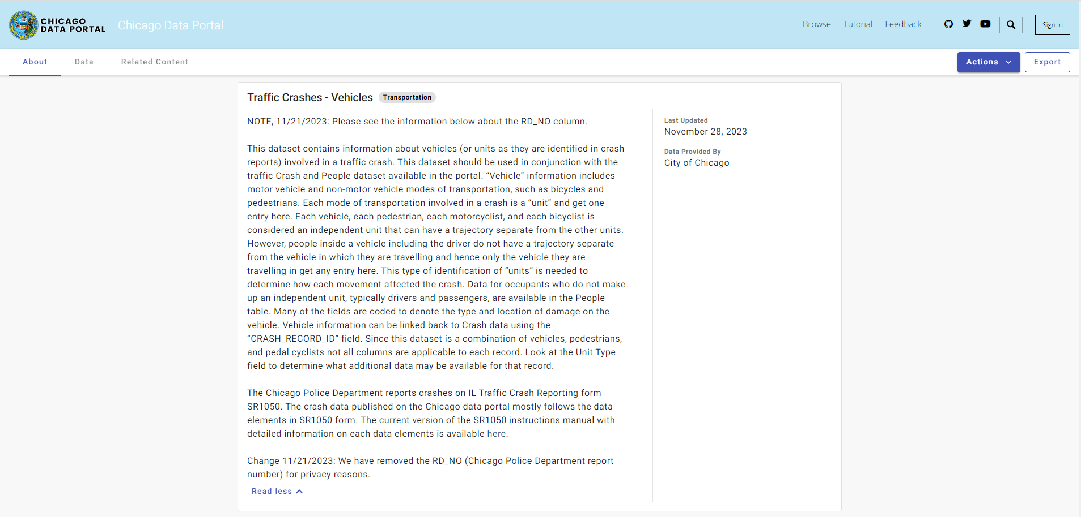
Dataset description – Vehicles involved in crash

Slide 12
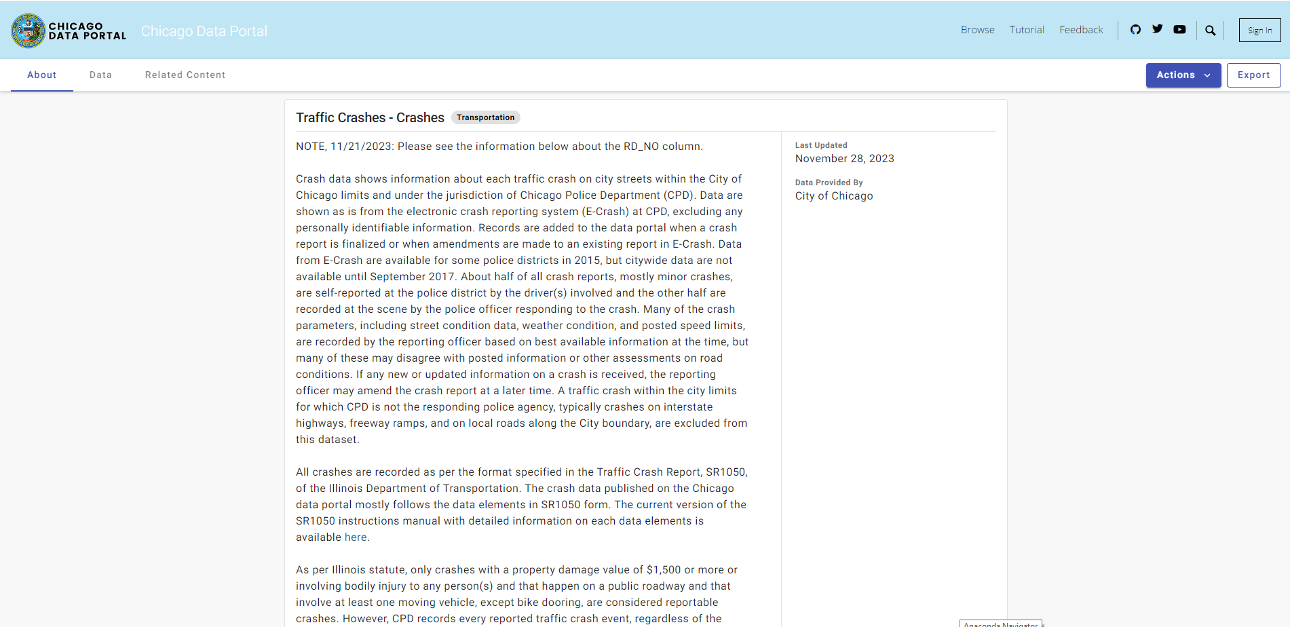
Dataset description - Information about each traffic crash

Slide 13
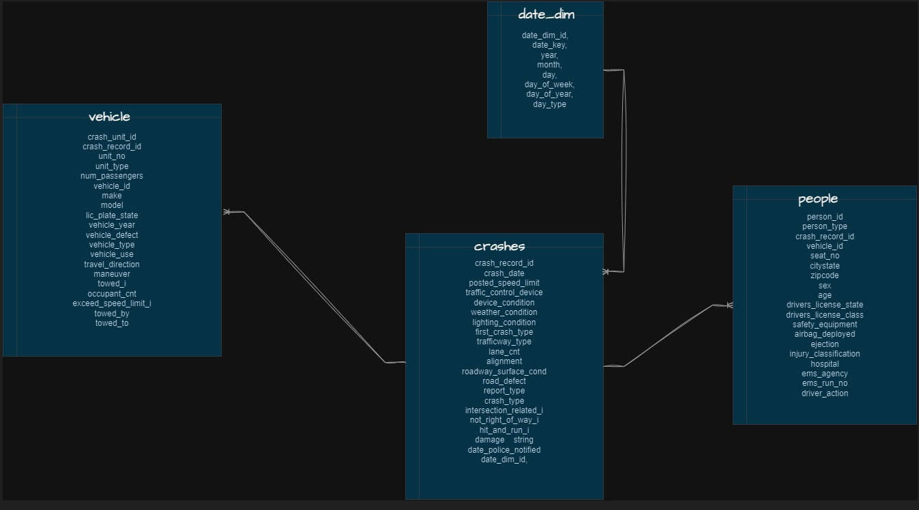
Entity-Relationship Diagram

Slide 14
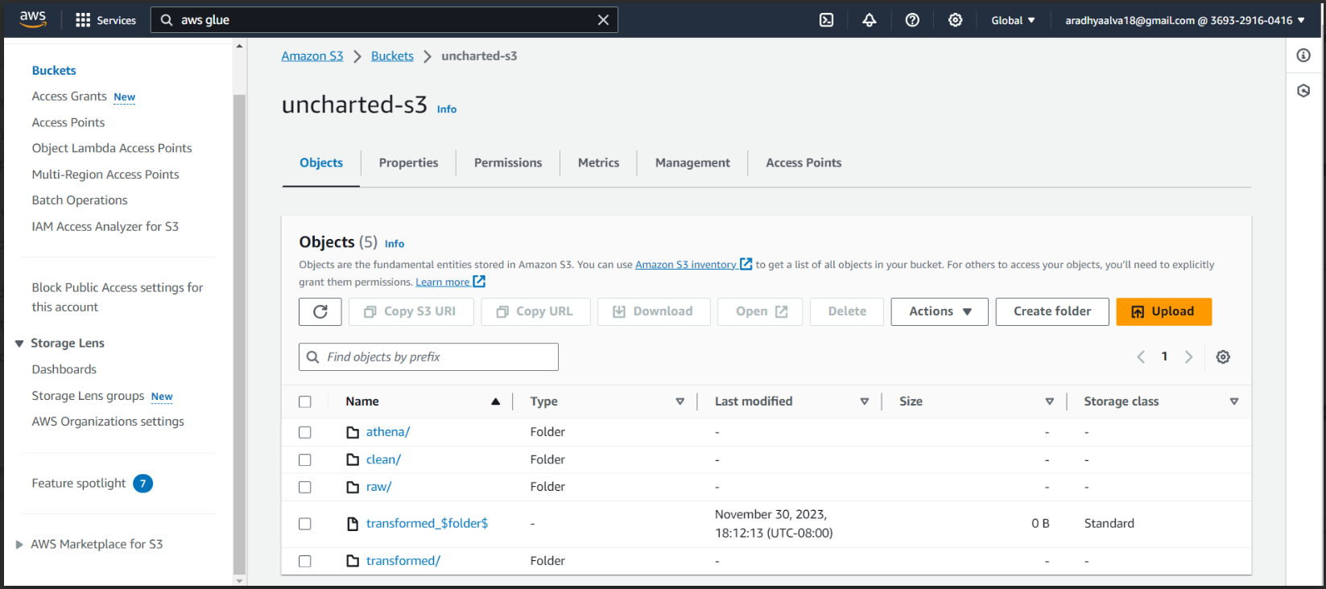
AWS S3 bucket for storage

Slide 15
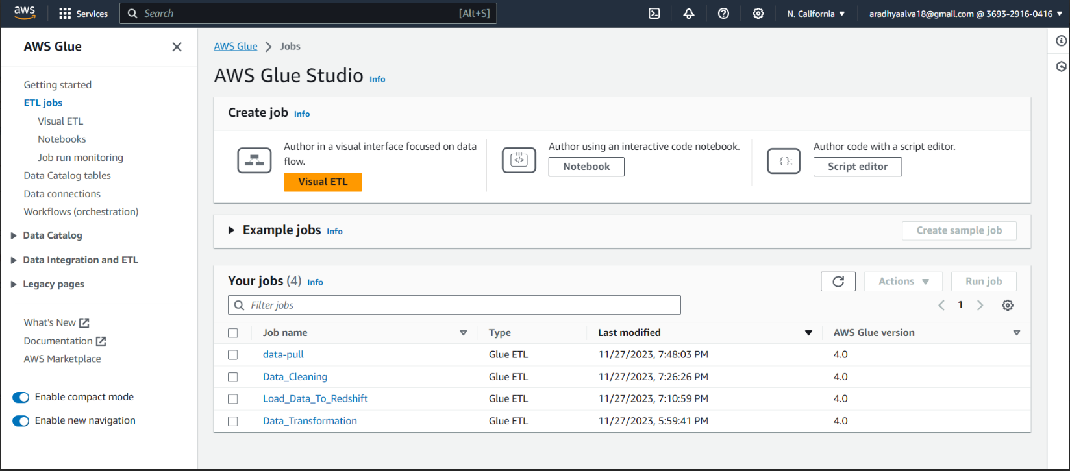
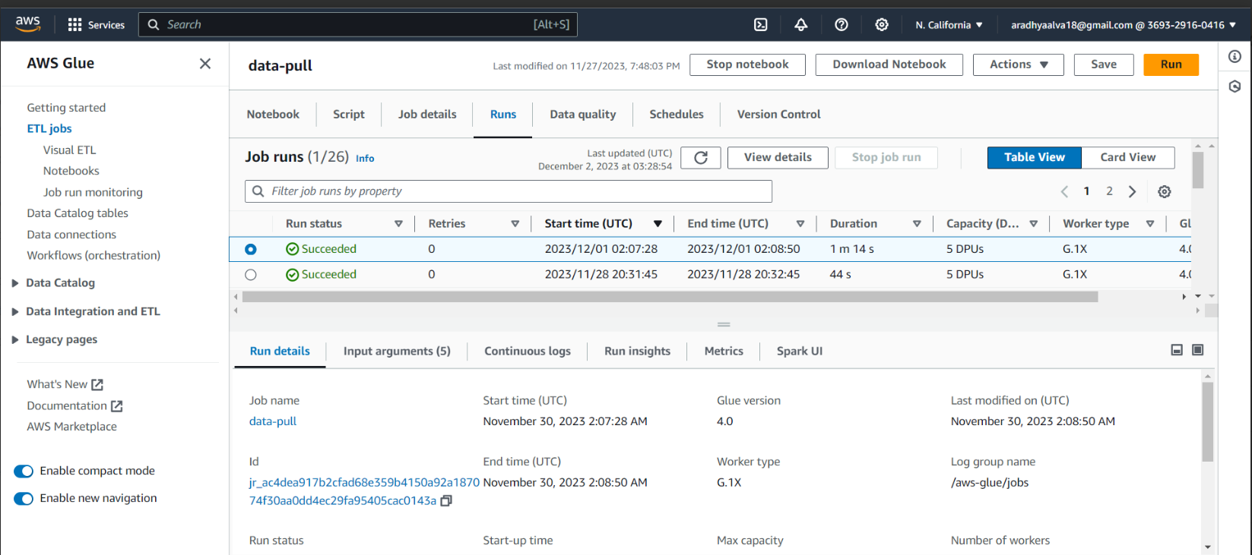
AWS Glue jobs for ETL

Slide 16
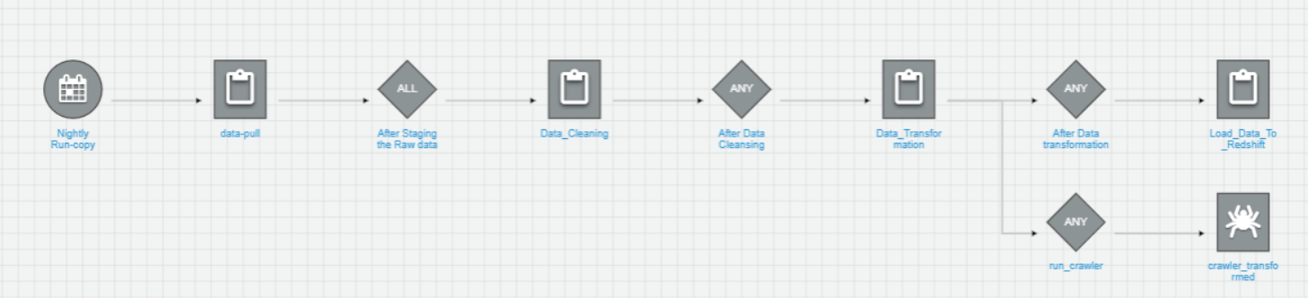
AWS Glue workflow for ETL

Slide 17
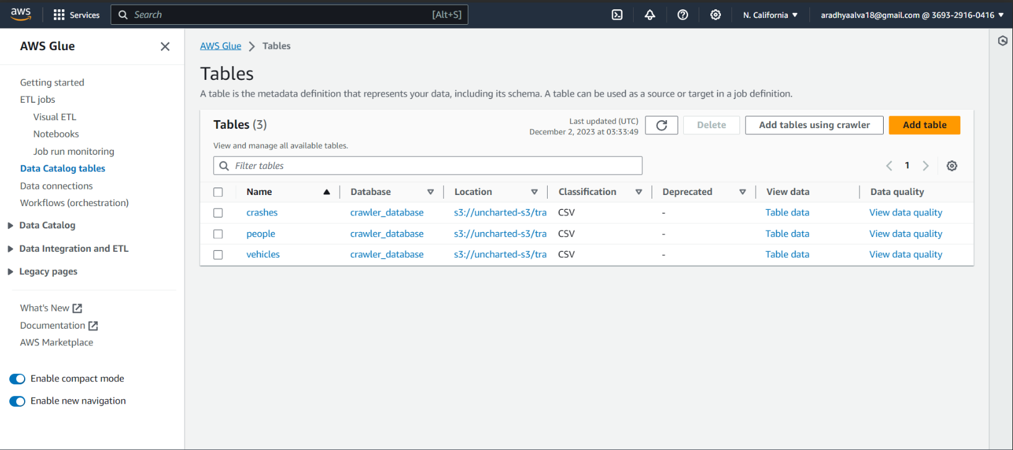
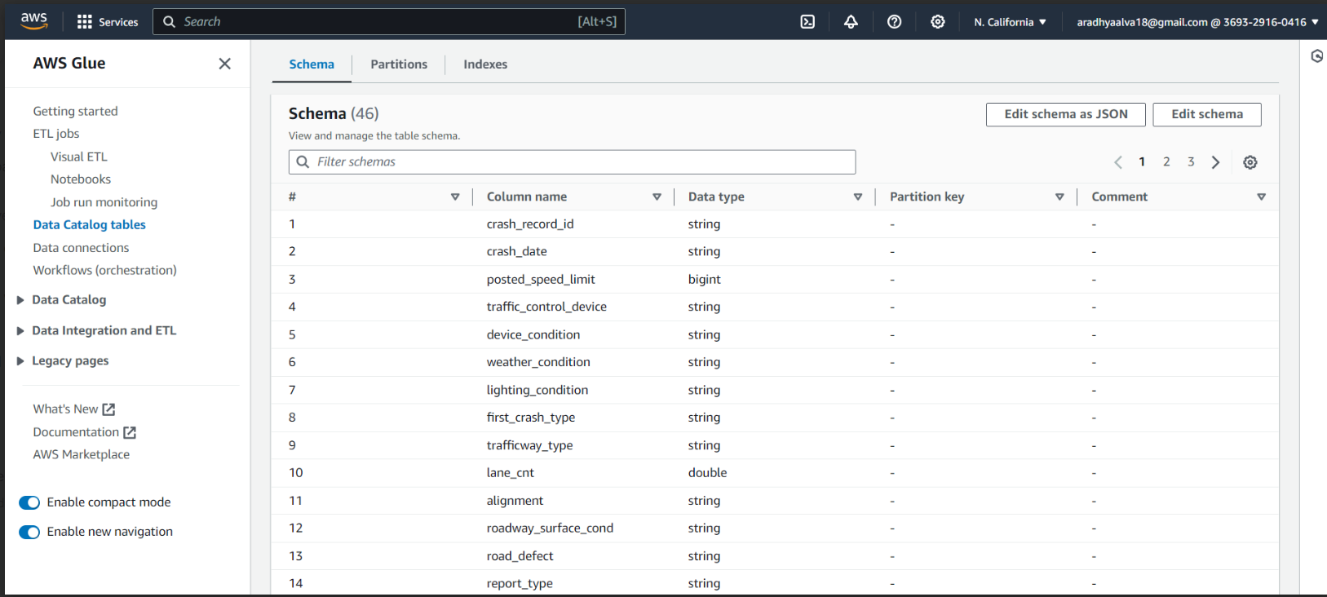
AWS Glue Crawlers

Slide 18
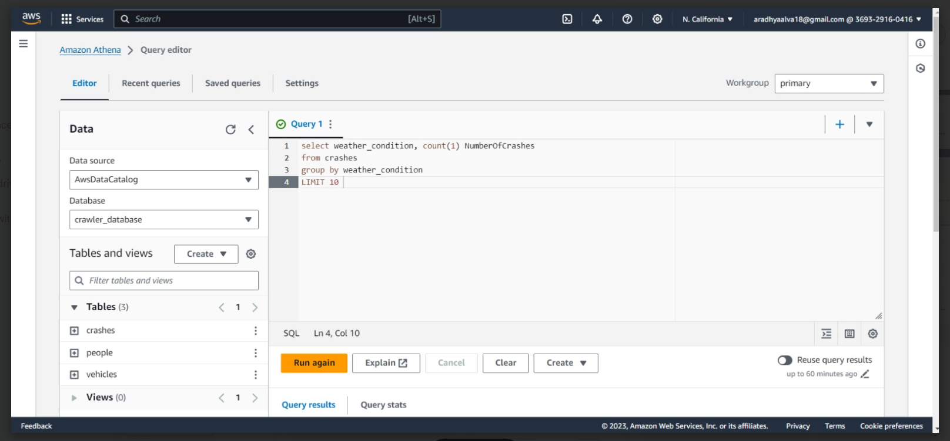
AWS Athena for Data Verification

Slide 19
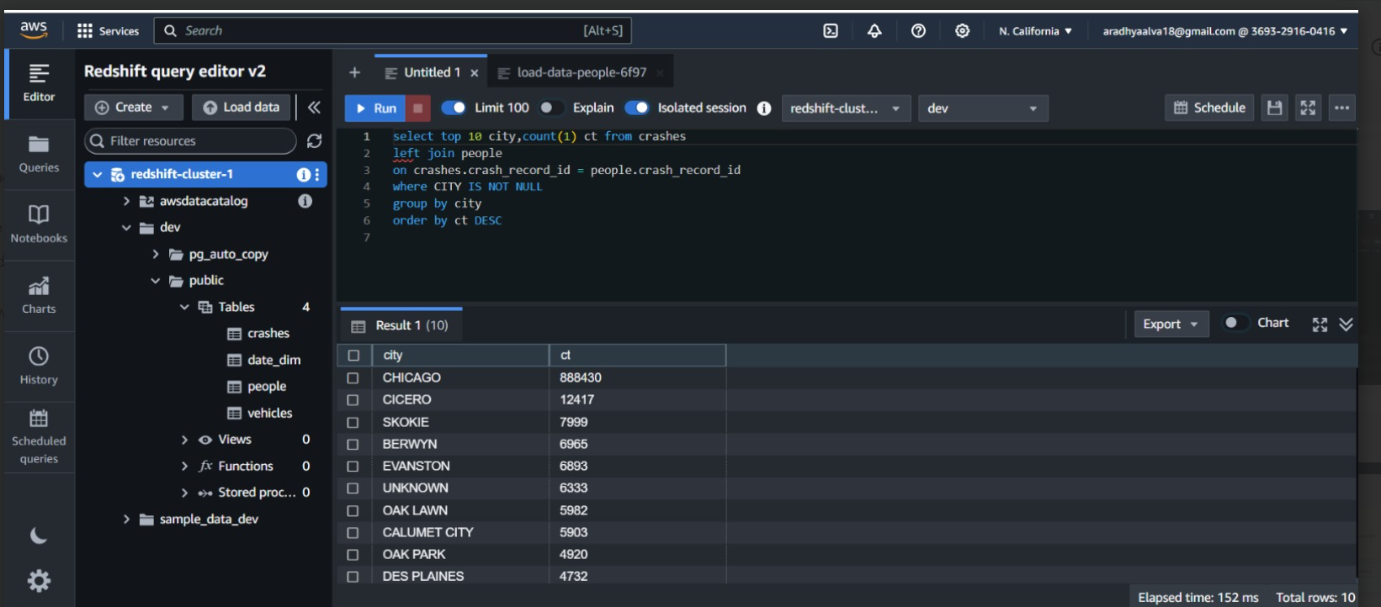
AWS Redshift for Data Warehouse

Slide 20
A Comprehensive Exploration on Road Traffic Safety and Crash Analysis
Captured the data from Amazon Redshift and imported it into Quick sight
Performed visualizations on basis of Crashes, Damage, Vehicle, and Environment factored data.
One dashboard with three diverse type sheets are visualized and published.
Published Link: Amazon Quick sight

Slide 21
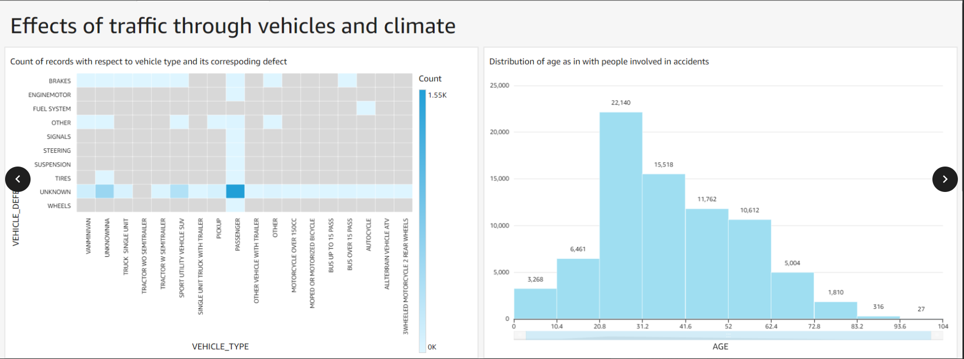
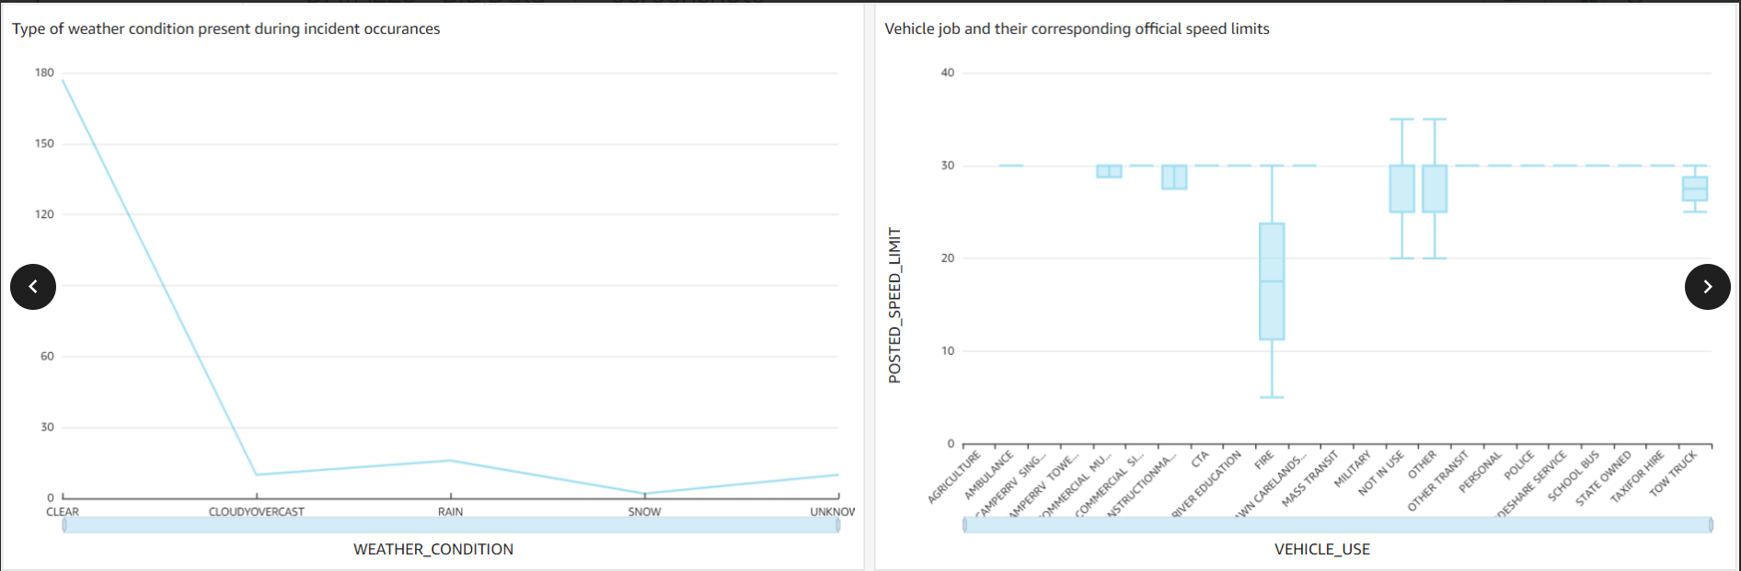
Quick sight for visualizations

Slide 22

Live Demo Walkthrough

Slide 23
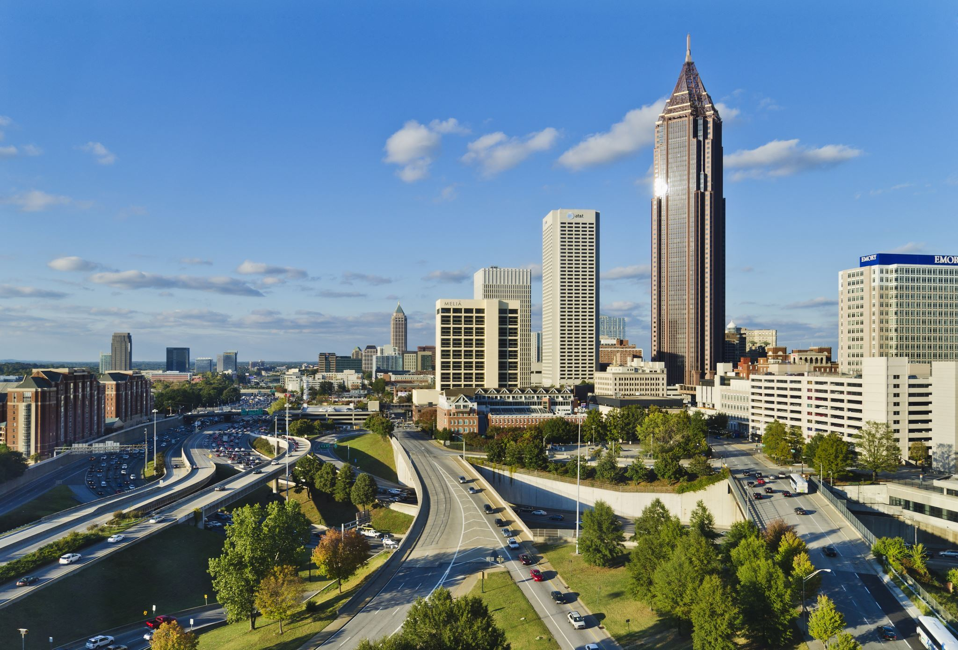
Conclusion
The project outlined a big data approach for analyzing road traffic to develop efficient management strategies and infrastructure solutions to address congestion challenges and enhance commuting experiences in Chicago.

Slide 24
Future Scope
Predictive Safety Measures
Implement predictive modeling to anticipate high-risk periods and locations, enabling proactive safety measures.
Smart Infrastructure Integration
Integrate smart infrastructure technologies for real-time monitoring, facilitating data-driven adjustments to enhance road safety.

Slide 25


Thank you !!

